Slide 1

Business Insights 360
$
€

Slide 2
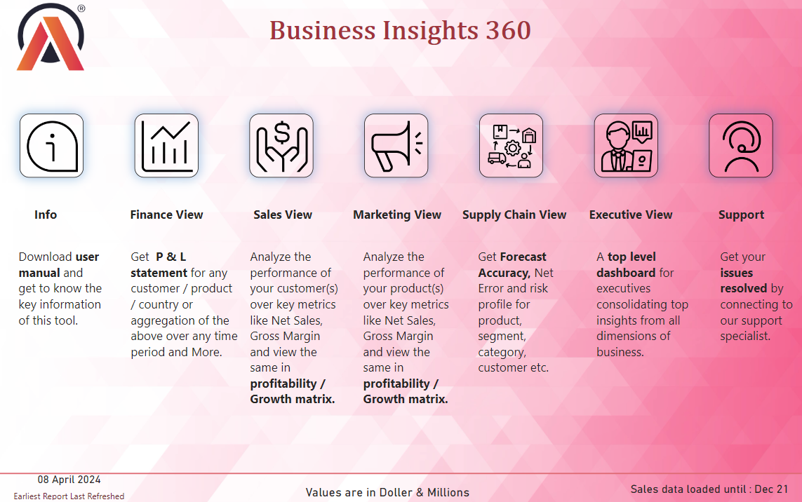

Slide 3
Company Introduction
AtliQ Hardware is a manufacturer and supplier of computer hardware and peripherals across different regions such as APAC, EU, LATAM and NA.
The company sells products in different segments including accessories, desktops, networking, notebooks, peripherals and storage.
They employ both brick-mortar and e-commerce sales channels and they distribute their products through retailers, direct sales and distributors.
We have dataset From 2019 to 2022.
AtliQ Fiscal year start from September to August.
$
€

Slide 4


Customers Information
Customers
Croma Store, Best Buy, Stapeles
Amazon, Flipkart, Vijay Sales
Brick & Mortar
Platforms
E-Commerce
Retailer Channel
Retailers Channel
Channels type

Slide 5


Customers Information
Customers
AtliQ E-store & AtliQ Exclusive
Neptune, Kem-Chho
Direct Channel
Distributor Channel
Channels type

Slide 6




Product Information
Division, Segments, Categories
PC
N & S
P & A
Desktop
Notebooks
Networking
Storage
Peripheral
Accessories
Gaming Laptops
Personal PC
Personal Laptop
Business Desktop
USB Drives
Wi Fi Routers
HDD
SSD
Mouse
Printers
Keyboards
Monitors
PC Cabin
Categories

Slide 7

Profit & Loss Statement Atliq Hardware
01
02
03
04
05
Pre-Invoice Deduction $2
Post-Invoice Deduction $3
Net Sales
COGS
GM/Profit
Gross Price of 1 = 30$
Gross price – pre invoice deduction = 28$ (NIS)
NIS – post invoice deduction = 25$
After all deductions Net Sales = 25 $
Cost of goods sold = 20$
Gross Margin / Profit for AtliQ for 1 = 5$
Manufacturing cost + freight cost + other costs
Yearly discount agreement made at the beginning of each financial year
GM % = GM/NS = 20%
Promotional offers +Placement Fees + Performance rebate

Slide 8
Problem Statement
AtliQ Hardware, a computer hardware company with a global presence, needs to update how it analyzes data.
They used to rely on Excel, but it's not enough anymore.
Now, they're starting a big project to change how they do data analytics.
Top bosses are leading the way because they believe in using data to make smart decisions and grow the company.
Some recent problems in Latin America made them realize they need better tools to deal with risks and find new opportunities around the world.
With a great team in charge, AtliQ is ready for this new data-driven journey.
They want to work better and become a leader in their field by using data in smarter ways.

